Slide 1
Search (Cont.)
CMSC 471
Intro to AI

Slide 2
General search algorithm
;; problem describes the start state, operators, goal test, and operator costs
;; queueing-function is a comparator function that ranks two states
;; general-search returns either a goal node or failure
function general-search (problem, QUEUEING-FUNCTION)
nodes = MAKE-QUEUE(MAKE-NODE(problem.INITIAL-STATE))
loop
if EMPTY(nodes) then return "failure"
node = REMOVE-FRONT(nodes)
if problem.GOAL-TEST(node.STATE) succeeds
then return node
nodes = QUEUEING-FUNCTION(nodes, EXPAND(node,
problem.OPERATORS))
end
;; Note: The goal test is NOT done when nodes are generated
;; Note: This algorithm does not detect loops

Slide 3
Properties of Searching Strategies
Completeness
Guarantees finding a solution whenever one exists
Time complexity (worst or average case)
Usually measured by number of nodes expanded
Space complexity
Usually measured by maximum size of graph/tree during the search
Optimality/Admissibility
If a solution is found, is it guaranteed to be an optimal one, i.e., one with minimum cost

Slide 4
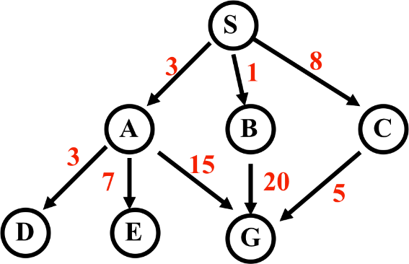
Uninformed Search (Recap)
Search Strategy | Expanded nodes
BFS
DFS
Iterative-Deepening Search
Uniform-Cost Search

Slide 5
Uninformed Search (Recap)
Search Strategy | Expanded nodes
BFS | SABCDEG
DFS | S A D E G
Iterative-Deepening Search | S S A B C S A D E G
Uniform-Cost Search | S A D B C E G

Slide 6
Comparing Search Strategies
Search Strategy | Time | Space | Complete? | Optimal?
BFS
DFS
Iterative-Deepening Search
Uniform-Cost Search
b = Branching Factor ; d = depth

Slide 7
Comparing Search Strategies
Search Strategy | Time | Space | Complete? | Optimal?
BFS | b^{d}
DFS | b^{d}
Iterative-Deepening Search | b^{d}
Uniform-Cost Search | b^{d}
b = Branching Factor ; d = depth

Slide 8
Comparing Search Strategies
Search Strategy | Time | Space | Complete? | Optimal?
BFS | b^{d} | b^{d}
DFS | b^{d} | bd
Iterative-Deepening Search | b^{d} | bd
Uniform-Cost Search | b^{d} | b^{d}
b = Branching Factor ; d = depth

Slide 9
Comparing Search Strategies
Search Strategy | Time | Space | Complete? | Optimal?
BFS | b^{d} | b^{d} | Yes
DFS | b^{d} | bd | No
Iterative-Deepening Search | b^{d} | bd | Yes
Uniform-Cost Search | b^{d} | b^{d} | Yes
b = Branching Factor ; d = depth

Slide 10
Comparing Search Strategies
Search Strategy | Time | Space | Complete? | Optimal?
BFS | b^{d} | b^{d} | Yes | Yes (Only for unitary cost)
DFS | b^{d} | bd | No | No
Iterative-Deepening Search | b^{d} | bd | Yes | Yes (Only for unitary cost)
Uniform-Cost Search | b^{d} | b^{d} | Yes | Yes
b = Branching Factor ; d = depth

Slide 11
Notes on Uniform-Cost Search
Greedy Algorithm
Algorithms that make locally optimal choice in the hopes of reaching global optima
Uniform because:
Tries to reach uniform cost on the priority queue or node list

Slide 12
UCS vs BFS vs DFS
DFS:
Goes too far down the depth before backtracking
Can find solution in less time
BFS:
Goes too far down the width before backtracking
Optimal
UCS
Tries to find a balance between going too far deep or wide

Slide 13
Informed (Heuristic) Search
Heuristic search
Best-first search
–Greedy search
–Beam search
–A* Search
Heuristic functions

Slide 14
Big idea: heuristic
Merriam-Webster's Online Dictionary:
Heuristic (pron. \hyu-’ris-tik\): adj. [from Greek heuriskein to discover] involving or serving as an aid to learning, discovery, or problem-solving by experimental and especially trial-and-error methods

Slide 15
Heuristics, More Formally
ℎ(𝑛) is a heuristic function, that maps a state 𝑛
to an estimated cost from 𝑛-to-goal

Slide 16
Heuristics, More Formally
ℎ(𝑛) is a heuristic function, that maps a state 𝑛
to an estimated cost from 𝑛-to-goal
ℎ(𝑛) is admissible iff ℎ 𝑛 ≤ the lowest actual cost from 𝑛-to-goal

Slide 17
Heuristics, More Formally
ℎ(𝑛) is a heuristic function, that maps a state 𝑛
to an estimated cost from 𝑛-to-goal
ℎ(𝑛) is admissible iff ℎ 𝑛 ≤ the lowest actual cost from 𝑛-to-goal
ℎ(𝑛) is consistent iff
ℎ 𝑛 ≤ lowestcost 𝑛, 𝑛′ + ℎ(𝑛′)

Slide 18
Informed methods add domain-specific information
Select best path along which to continue searching
h(n): estimates goodness of node n
h(n) = estimated cost (or distance) of minimal cost path from n to a goal state.
Based on domain-specific information and computable from current state description that estimates how close we are to a goal

Slide 19
Heuristics
All domain knowledge used in search is encoded in the heuristic function, h(<node>)
Examples:
–8-puzzle: number of tiles out of place
–8-puzzle: sum of distances each tile is from its goal
In general
ℎ(𝑛) ≥ 0 for all nodes n
ℎ(𝑛) = 0 implies that n is a goal node
ℎ(𝑛) = ∞ implies n is a dead-end that can’t lead to goal

Slide 20
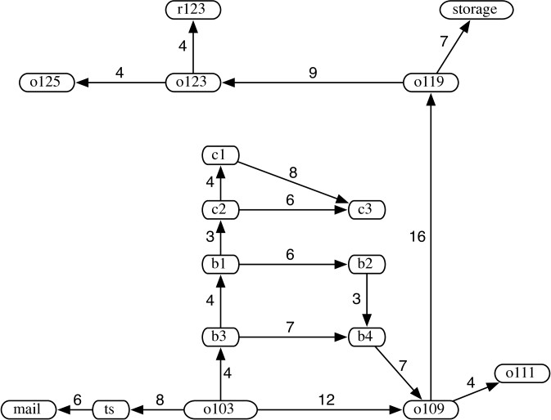
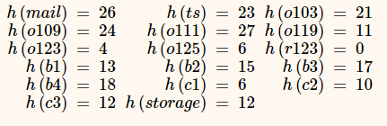
Example 3.5
(Partial) Heuristic ℎ(𝑛)
for goal r123

Slide 21
Example 3.5
(Partial) Heuristic ℎ(𝑛)
for goal r123

Slide 22
Example 3.5
Q: Is this an admissible
heuristic?
(Partial) Heuristic ℎ(𝑛)
for goal r123

Slide 23
Example 3.5
Q: Is this an admissible
heuristic?
Q: Is it an accurate
heuristic?
(Partial) Heuristic ℎ(𝑛)
for goal r123

Slide 24
Heuristics for 8-puzzle
1 | 2 | 3
4 | 5 | 6
7 |  | 8
Current State
 | 1 |  | 2 |  | 3
 | 4 |  | 5 |  | 6
 | 7 |  |  |  | 8
The number of misplaced tiles (not including the blank)
1
2
3
4
5
6
1 | 2 | 3
4 | 5 | 6
7 | 8
Goal
State
7
8
N | N | N
N | N | N
N | Y
In this case, only “8” is misplaced, so heuristic
function evaluates to 1
In other words, the heuristic says that it thinks a solution may be available in just 1 more move

Slide 25
Heuristics for 8-puzzle
3 3
Manhattan Distance (not including the blank)
3 | 2 | 8
4 | 5 | 6
7 | 1
Current State
2 spaces
8
8
1 | 2 | 3
4 | 5 | 6
7 | 8
Goal
State
3 spaces
1
1
The 3, 8 and 1 tiles are misplaced (by 2, 3, and 3 steps) so the heuristic function evaluates to 8
Heuristic says that it thinks a solution may be available in just 8 more moves.
The misplaced heuristic’s value is 3
3 spaces
Total 8

Slide 26
We can use heuristics to guide search
1 | 2 | 3
4 | 8
7 | 6 | 5
5
1 | 2
4 | 8 | 3
7 | 6 | 5
1 | 2 | 3
4 | 8 | 5
7 | 6
6
4
 | 1 | 2 | 3
 | 4 | 8 | 5
 | 7 |  | 6
3
Manhattan Distance heuristic helps us quickly find a solution to the 8- puzzle
 | 1 | 2 | 3
 | 4 | 8 | 5
 |  | 7 | 6
1 | 2 |  | 3
4 |  |  | 5
7 | 8 |  | 6
4
2
1 | 2 | 3
4 | 5
7 | 8 | 6
1 | 2 | 3
 | 4 | 5
7 | 8 | 6
1 |  | 3
4 | 2 | 5
7 | 8 | 6
1
3
3
1 | 2 | 3
4 | 5 | 6
7 | 8
1 | 2
4 | 5 | 3
7 | 8 | 6
goal
0
2

Slide 27
Best-first search
Search algorithm that improves depth- first search by expanding most promising node chosen according to heuristic rule
Order nodes on nodes list by increasing value of an evaluation function, f(n), incorporating domain-specific information

Slide 28
Best-first search
Search algorithm that improves depth- first search by expanding most promising node chosen according to heuristic rule
Order nodes on nodes list by increasing value of an evaluation function, f(n), incorporating domain-specific information
This is a generic way of referring to the class of informed methods

Slide 29
Greedy best first search
A greedy algorithm makes locally optimal choices in hope of finding a global optimum
Uses evaluation function f(n) = h(n), sorting nodes by increasing values of f
Selects node to expand appearing closest to goal (i.e., node with smallest f value)
Not complete
Not Admissible

Slide 30
Greedy best first search example
a
b
c d e
g
h
h=2
h=4
Proof of non-admissibility
Assume arc costs = 1, greedy search finds goal g, with solution cost of 5
Optimal solution is path to
goal with cost 3
h=1
i
h=1
h=1
h=0
g2
h=1
h=0

Slide 31
Beam search
Use evaluation function f(n), but maximum size of the nodes list is k, a fixed constant
Only keep k best nodes as candidates for expansion, discard rest
k is the beam width
More space efficient than greedy search, but may discard nodes on a solution path
As k increases, approaches best first search
Complete?
Admissible?

Slide 32
Beam search
Use evaluation function f(n), but maximum size of the nodes list is k, a fixed constant
Only keep k best nodes as candidates for expansion, discard rest
k is the beam width
More space efficient than greedy search, but may discard nodes on a solution path
As k increases, approaches best first search
Not Complete
Not Admissible

Slide 33
We’ve got to be able to do better, right?

Slide 34
A* Search
Use an evaluation function
f(n) = g(n) + h(n)
estimated total cost from start to goal via state n
minimal-cost path from the start state to state n
cost estimate from state n to the goal

Slide 35
A* Search
Use an evaluation function
f(n) = g(n) + h(n)
estimated total cost from
start to goal via state n
minimal-cost path from
the start state to state n
cost estimate from state n
to the goal
g(n) term adds “breadth-first” component to evaluation function
Ranks nodes on search frontier by estimated cost of solution from start node via given node to goal

Slide 36
A*
Pronounced “a star”
h is admissible when h(n) <= h*(n) holds
– h*(n) = true cost of minimal cost path from n to a goal
Using an admissible heuristic guarantees that 1st solution found will be an optimal one
A* is complete whenever branching factor is finite and every action has fixed, positive cost
A* is admissible
Hart, P. E.; Nilsson, N. J.; Raphael, B. (1968). "A Formal Basis for the Heuristic Determination of Minimum Cost Paths". IEEE Transactions on Systems Science and Cybernetics SSC4 4 (2): 100–107.

Slide 37
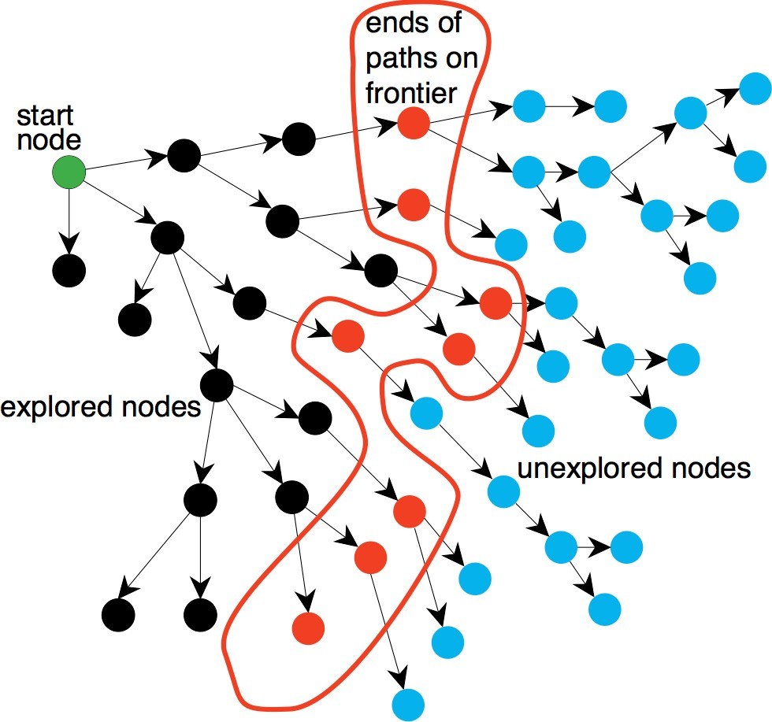
Implementing A*
Q: Can this be an instance of our general search algorithm?
Figure 3.3

Slide 38
Implementing A*
Q: Can this be an instance of our general search algorithm?
A: Yup! Just make the fringe a priority queue ordered by
𝑓(𝑛)
Figure 3.3

Slide 39
Alternative A* Pseudo-code
Put the start node S on the nodes list, called OPEN
If OPEN is empty, exit with failure
Select node in OPEN with minimal f(n) and place on CLOSED
If n is a goal node, collect path back to start and stop
Expand n, generating all its successors and attach to them pointers back to n. For each successor n' of n
If n’ not already on OPEN or CLOSED
put n' on OPEN
compute h(n'), g(n')=g(n)+ c(n,n'), f(n')=g(n')+h(n')
If n’ already on OPEN or CLOSED and if g(n') is lower for new
version of n', then:
Redirect pointers backward from n’ on path with lower g(n’)
Put n' on OPEN
Notes:
Show example

Slide 40
Observations on A*
Perfect heuristic: If h(n) = h*(n) for all n, only nodes on an optimal solution path expanded; no extra work is done

Slide 41
Observations on A*
Perfect heuristic: If h(n) = h*(n) for all n, only nodes on an optimal solution path expanded; no extra work is done
Null heuristic: If h(n) = 0 for all n, then it is an admissible heuristic and A* acts like uniform-cost search

Slide 42
Observations on A*
Perfect heuristic: If h(n) = h*(n) for all n, only nodes on an optimal solution path expanded; no extra work is done
Null heuristic: If h(n) = 0 for all n, then it is an admissible heuristic and A* acts like uniform-cost search
Better heuristic: If h1(n) < h2(n) <= h*(n) for all non-goal nodes, then h2 is a better heuristic than h1

Slide 43
Observations on A*
Perfect heuristic: If h(n) = h*(n) for all n, only nodes on an optimal solution path expanded; no extra work is done
Null heuristic: If h(n) = 0 for all n, then it is an admissible heuristic and A* acts like uniform-cost search
Better heuristic: If h1(n) < h2(n) <= h*(n) for all non-goal nodes, then h2 is a better heuristic than h1
– If A1* uses h1, and A2* uses h2, then every node expanded by A2* is also expanded by A1*
i.e., A1 expands at least as many nodes as A2*
– We say that A2* is better informed than A1*

Slide 44
Observations on A*
Perfect heuristic: If h(n) = h*(n) for all n, only nodes on an optimal solution path expanded; no extra work is done
Null heuristic: If h(n) = 0 for all n, then it is an admissible heuristic and A* acts like uniform-cost search
Better heuristic: If h1(n) < h2(n) <= h*(n) for all non-goal nodes, then h2 is a better heuristic than h1
– If A1* uses h1, and A2* uses h2, then every node expanded by A2* is also expanded by A1*
i.e., A1 expands at least as many nodes as A2*
– We say that A2* is better informed than A1*
The closer h to h*, the fewer extra nodes expanded

Slide 45
Proof of the optimality of A*
Assume that A* has selected G2, a goal state with a suboptimal solution, i.e., g(G2) > f*
Proof by contradiction shows it’s impossible

Slide 46
Proof of the optimality of A*
Assume that A* has selected G2, a goal state with a suboptimal solution, i.e., g(G2) > f*
Proof by contradiction shows it’s impossible
– Choose a node n on an optimal path to G
– Because h(n) is admissible, f* >= f(n)
– If we choose G2 instead of n for expansion, then f(n) >= f(G2)
– This implies f* >= f(G2)
– G2 is a goal state: h(G2) = 0, f(G2) = g(G2).
– Therefore f* >= g(G2)
– Contradiction

Slide 47
How to find good heuristics
Some options (mix-and-match):
If h1(n) < h2(n) <= h*(n) for all n, h2 is better than (dominates) h1
Relaxing problem: remove constraints for easier problem; use its solution cost as heuristic function
Max of two admissible heuristics is a Combining heuristics: admissible heuristic, and it’s better!
Use statistical estimates to compute h; may lose admissibility
Identify good features, then use machine learning to find heuristic function; also may lose admissibility

Slide 48
Local Search
Iterative improvement methods (aka local search) move from potential solution to potential solution until a goal is reached

Slide 49
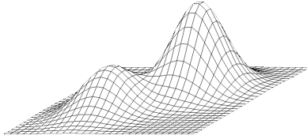
Hill Climbing
Extended current path with successor that’s closer to solution than end of current path
If goal is to get to the top of a hill, then always take a step that leads you up
Simple hill climbing: take any upward step
Steepest ascent hill climbing: consider all possible steps, take one that goes up most
No memory required

Slide 50
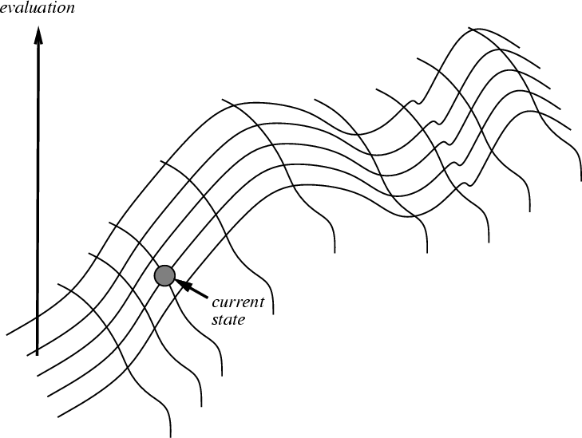
Hill climbing on a surface of states
Height defined by an evaluation function that takes a state & returns a number

Slide 51
Hill climbing for search
For informed search and many other problems (e.g., neural network training) we want to find a global minimum
Search evaluation function: measure of how far the current state is from a goal
It’s an easy change to make in the algorithm, or we can just negate the evaluation function
We still call it hill climbing though

Slide 52

Hill-climbing search
If there’s successor s for current state n such that
h(s) < h(n) and h(s) <= h(t) for all successors t
then move from n to s; otherwise, halt at n
i.e.: Look one step ahead to decide if a successor is better than current state; if so, move to best successor
Like greedy search, but doesn’t allow backtracking or jumping to alternative path since it has no memory
Like beam search with a beam width of 1 (i.e., maximum size of the nodes list is 1)
Not complete since search may terminate at a local minima, plateau or ridge

Slide 53
Hill climbing example
f(n) = -(number of tiles out of place)
2
8
3
1
2
3
start
1
6
4
h = -4
goal
8
4
h = 0
7
5
7
6
5
-5
-5
-2
2
8
3
1
2
3
1
4
h = -3
8
4
h = -1
7
6
5
7
6
5
-3
-4
2
3
2
3
1
8
4
1
8
4
h = -2
7
6
5
7
6
5
h = -3
-4

Slide 54
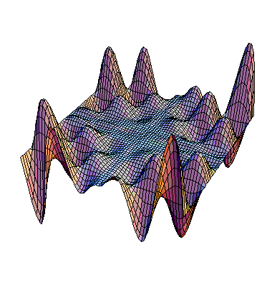
Drawbacks of hill climbing
Local Maxima: peaks not highest point in space
Plateaus: broad flat region giving search no guidance (use random walk)
Ridges: flat like plateaus, but with drop-offs to sides; steps to North, East, South and West may go down, but step to NW may go up
local maximum
plateau
ridge
Image from: http://classes.yale.edu/fractals/CA/GA/Fitness/Fitness.html

Slide 55
Example of a local optimum
2
5
-4
1
7
4
start
8
6
3
goal
1
2
5
1
2
5
1
2
3
7
4
7
4
-4
8
4
0
8
6
3
8
6
3
7
6
5
-3
1
2
5
8
7
4
-4
6
3

